Slide 1
CS639: Data Management for Data Science
Lecture 21: Information Extraction
Theodoros Rekatsinas

Slide 2
So far…
Manage data of various forms (structured, key-values, documents)
RDBMS
MadReduce
Key-value Stores
How to learn models that capture the distribution of observed data
Statistics and Statistical Inference
Linear Classifiers
Decision Trees
Unsupervised/Supervised learning
Optimization

Slide 3
Until the end of the semester…
Information extraction and Data Integration
Communicating insights
Visualizations and Privacy

Slide 4
Information Extraction
Extracting knowledge from unstructured data (e.g., text)
Recognize Named Entities in unstructured data
Clean and normalize extractions

Slide 5
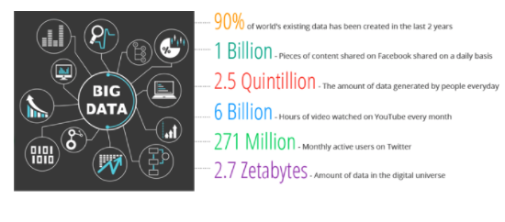
What is Information Extraction?
Goal: Mine knowledge from unstructured data

Slide 6
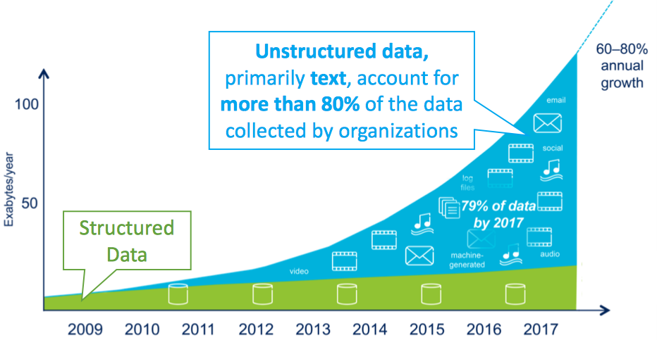
Growth of Unstructured Text Data

Slide 7
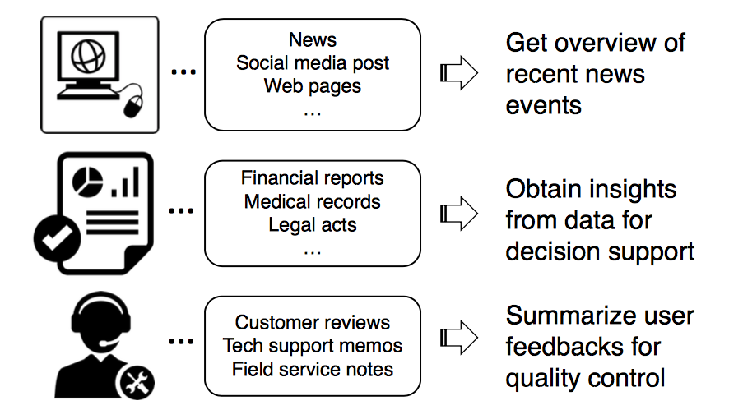
Knowledge in unstructured data

Slide 8

Knowledge from Unstructured Data (Example)

Slide 9
Personalized medicine

Slide 10
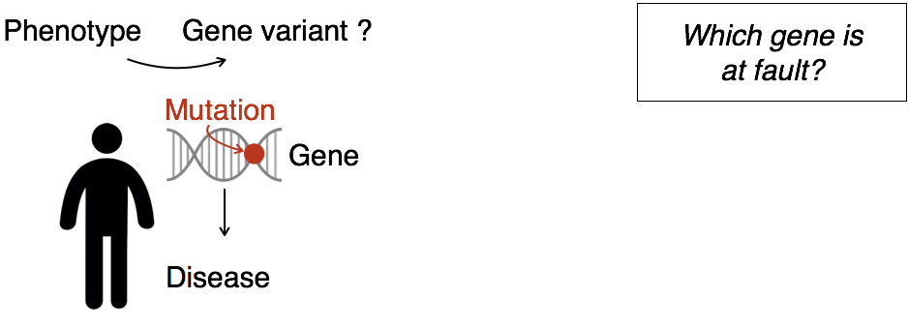
Personalized medicine

Slide 11
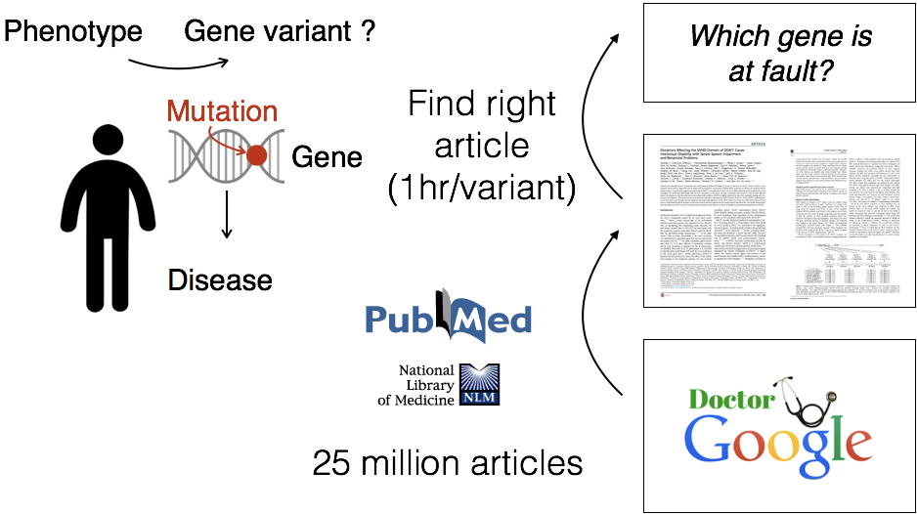
Personalized medicine

Slide 12
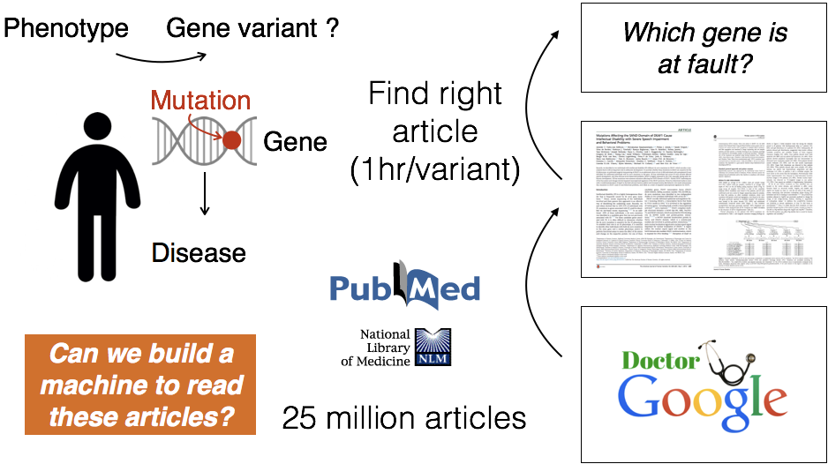
Personalized medicine

Slide 13
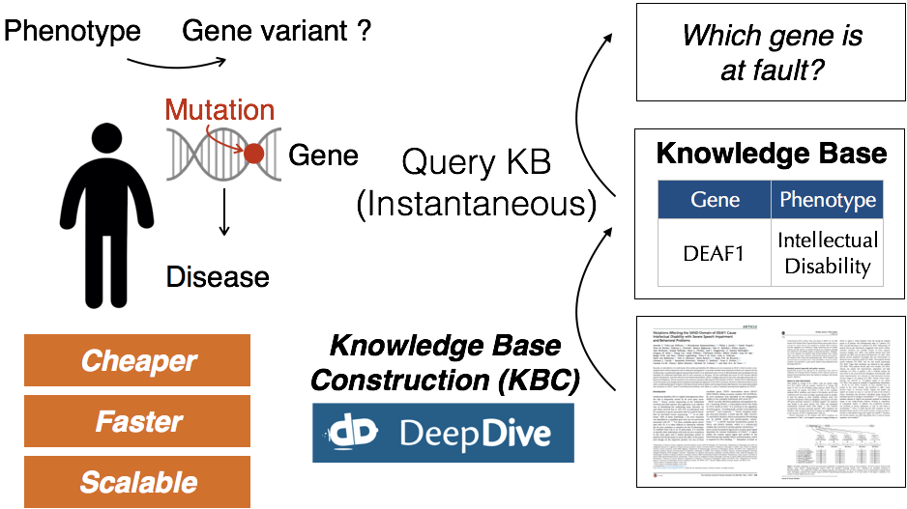
Personalized medicine

Slide 14
Knowledge Extraction from Unstructured Data
Step 1: Identify Entities of interest
Step 2: Identify relations that these entities participate in
Step 3(*): Identify events

Slide 15
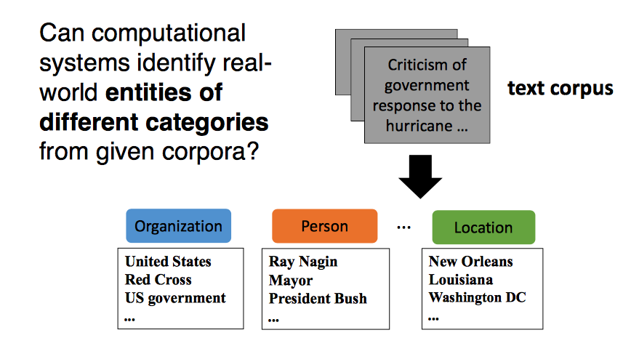
Entities

Slide 16
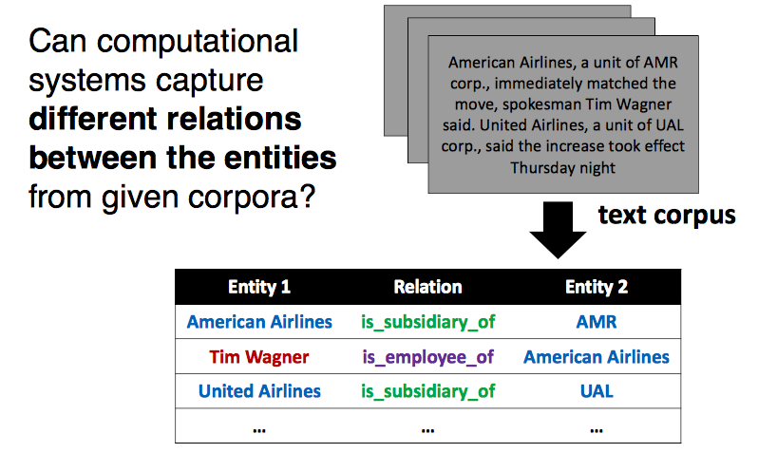
Relations

Slide 17
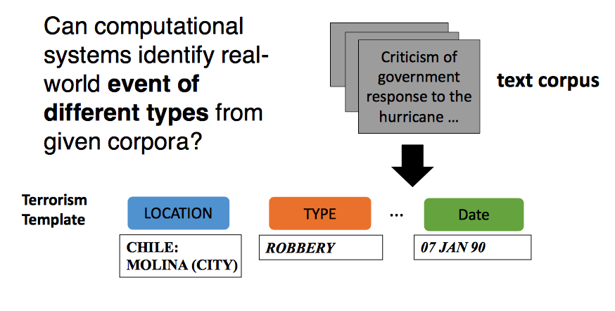
Events

Slide 18
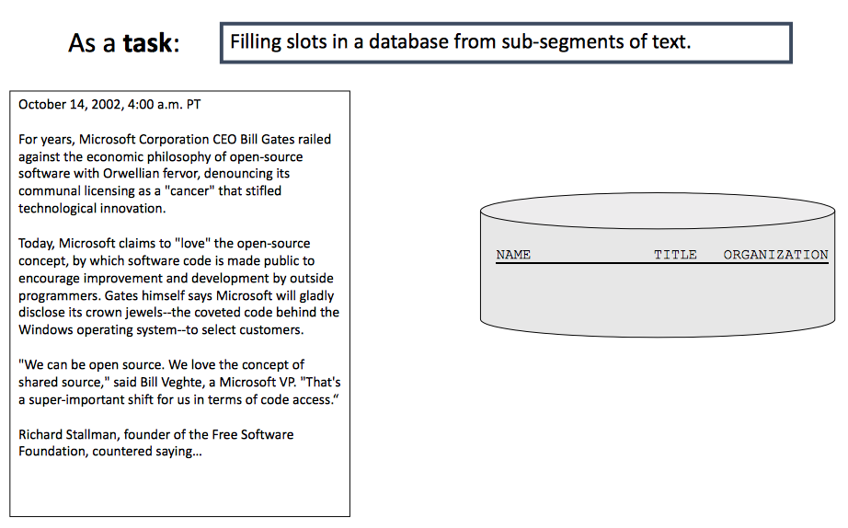
What is Information Extraction

Slide 19
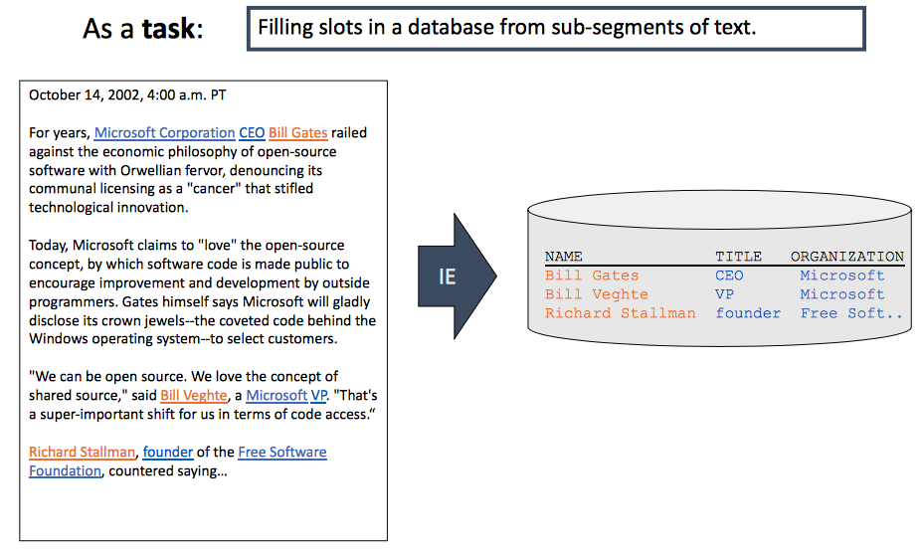
What is Information Extraction

Slide 20
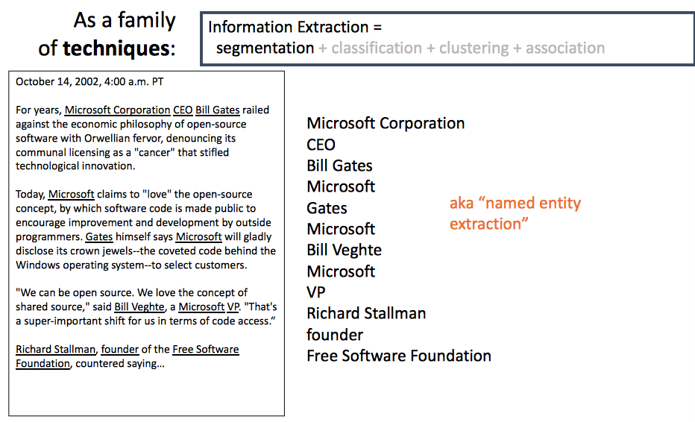
What is Information Extraction

Slide 21
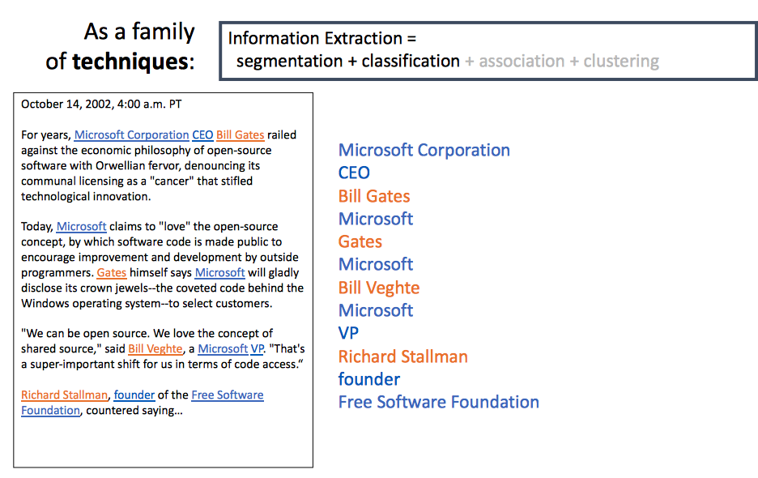
What is Information Extraction

Slide 22
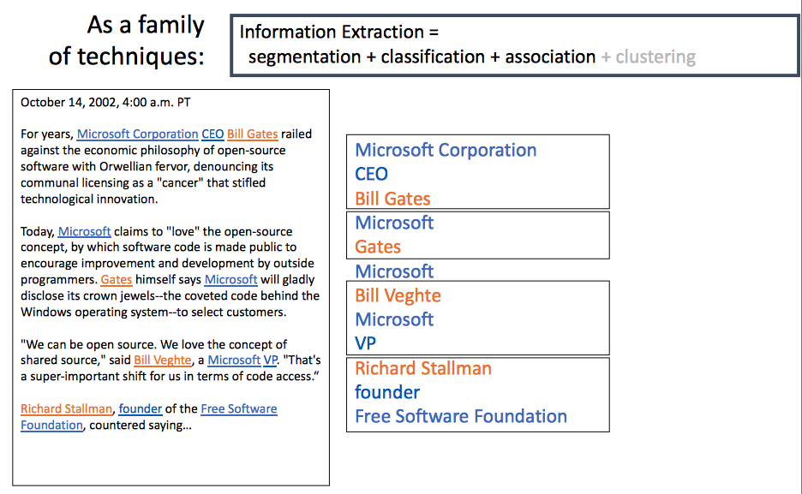
What is Information Extraction

Slide 23
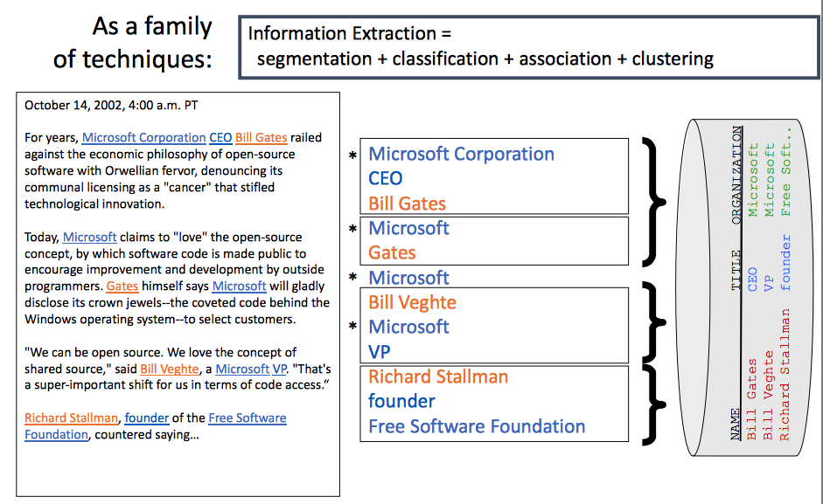
What is Information Extraction

Slide 24
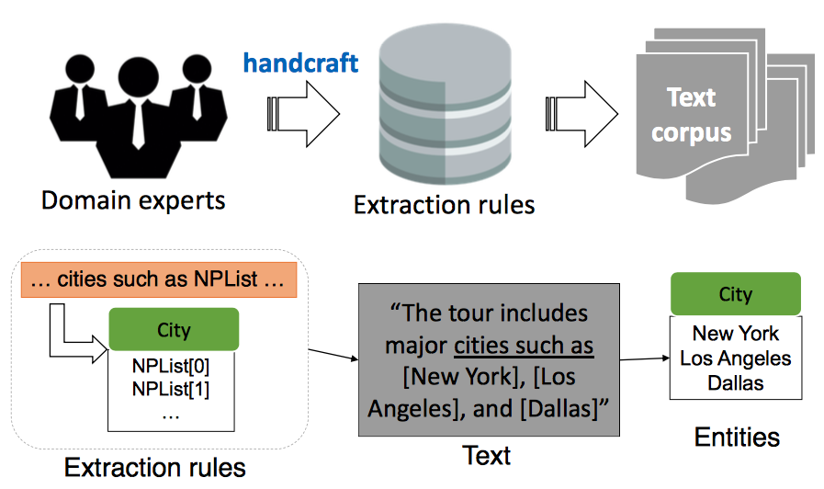
Traditional Rule-Based Systems

Slide 25
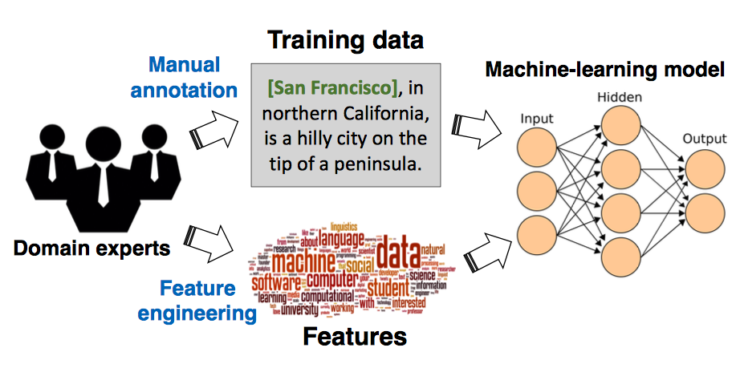
Supervised Machine Learning-Based Systems (state-of-the-art)

Slide 26
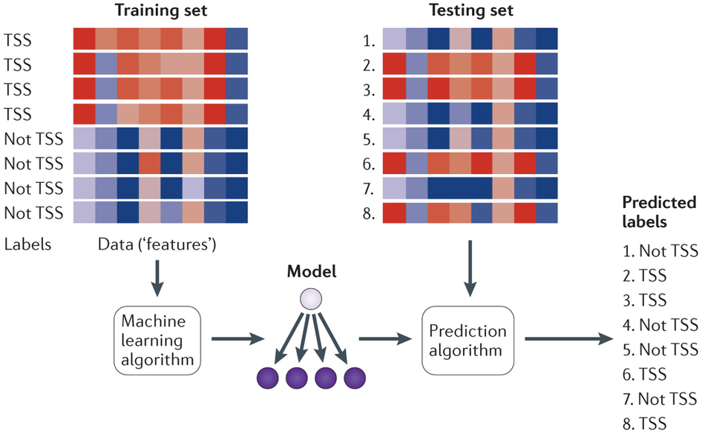
IE as Supervised Learning

Slide 27
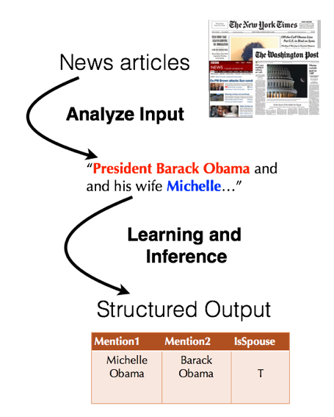
IE as Supervised Learning

Slide 28
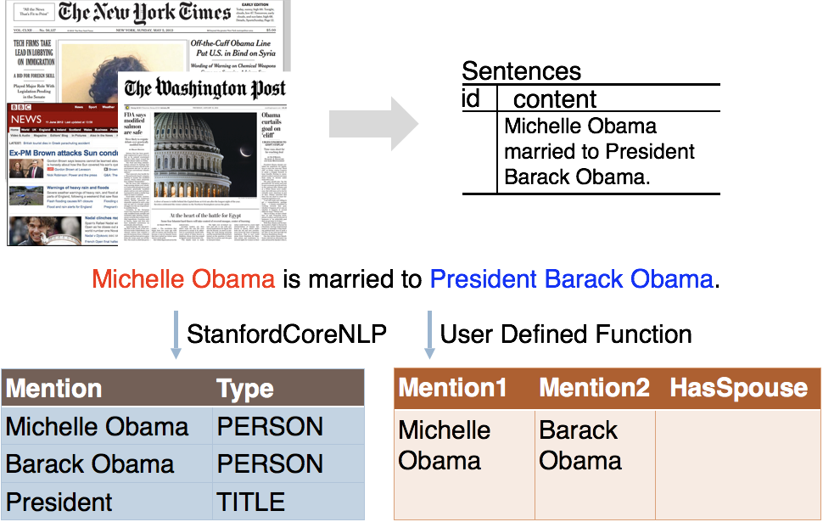
Candidate Extraction

Slide 29
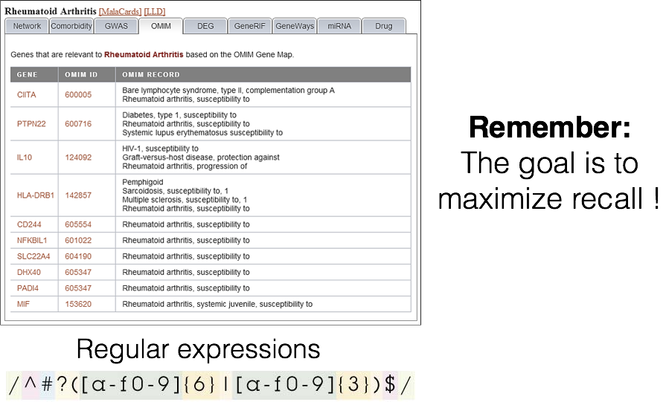
Candidate Extraction++

Slide 30
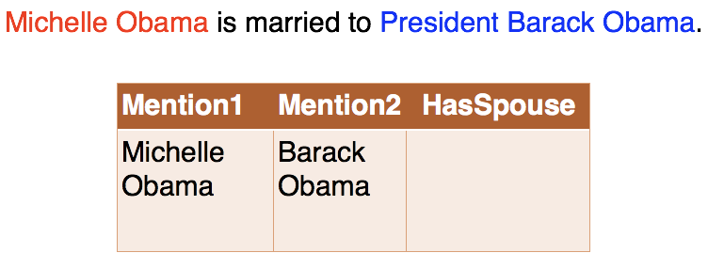
Feature Extraction

Slide 31
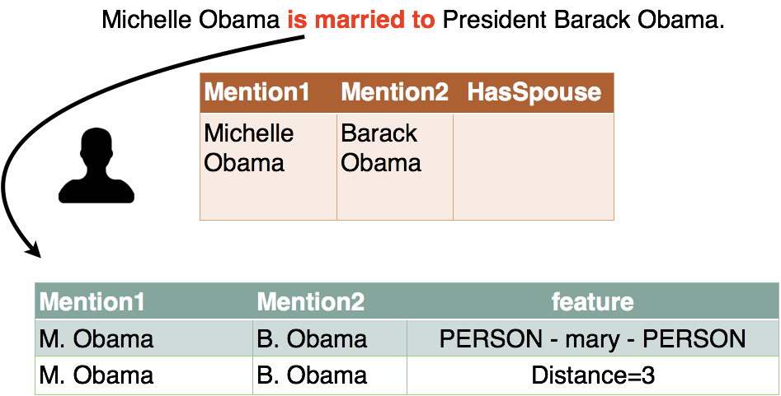
Feature Extraction

Slide 32
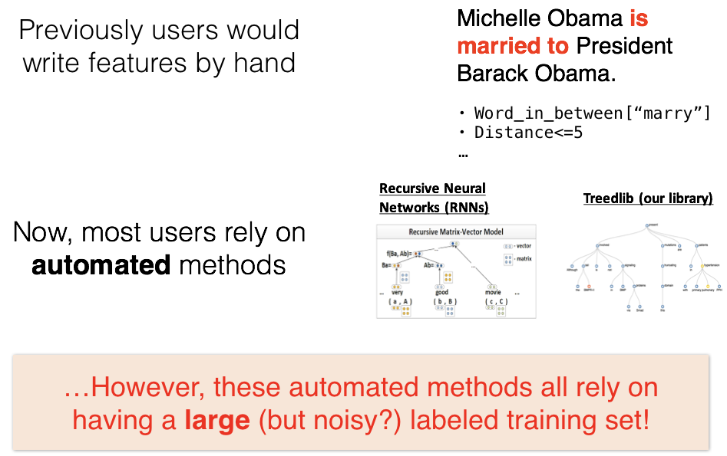
Feature Extraction

Slide 33
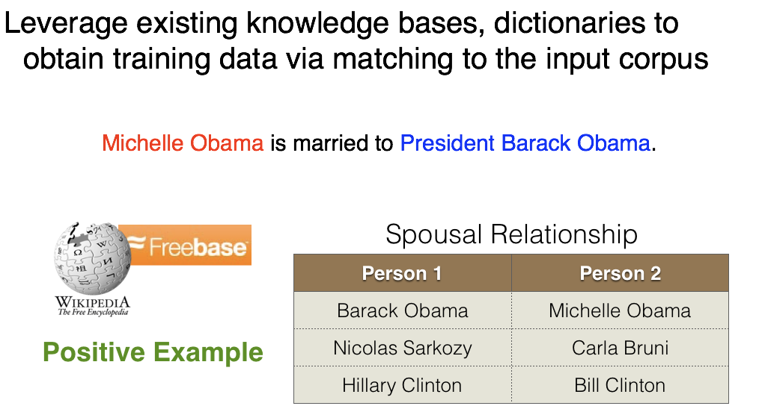
Distant Supervision

Slide 34
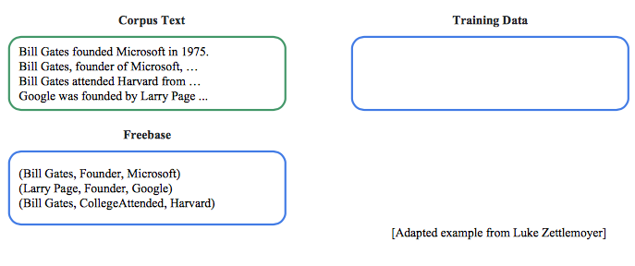
Distant Supervision

Slide 35
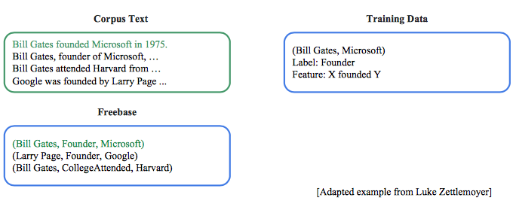
Distant Supervision

Slide 36
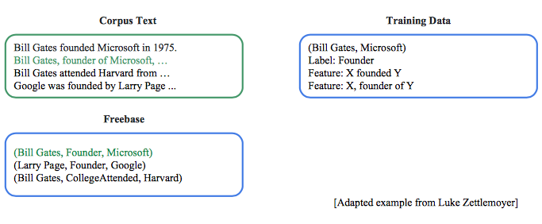
Distant Supervision

Slide 37
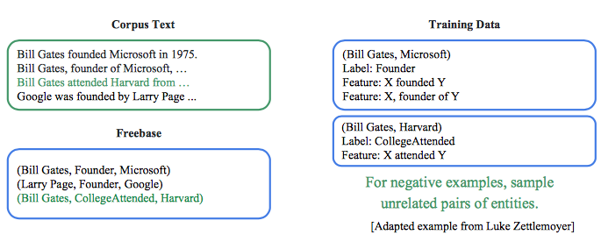
Distant Supervision

Slide 38
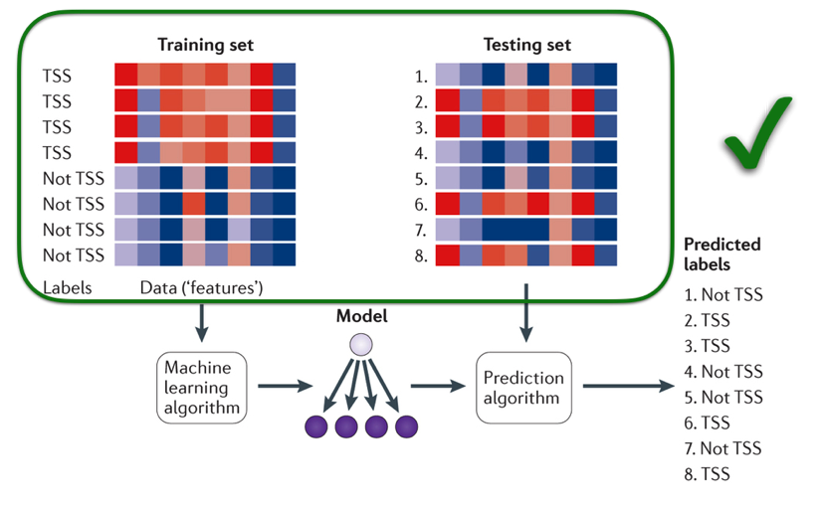
IE as supervised learning

Slide 39
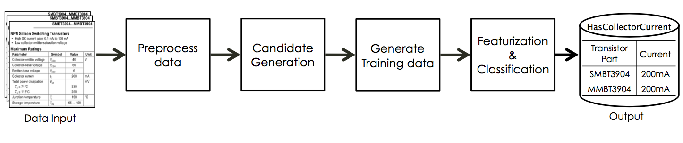
Fonduer: An example state-of-the-art system

Slide 40
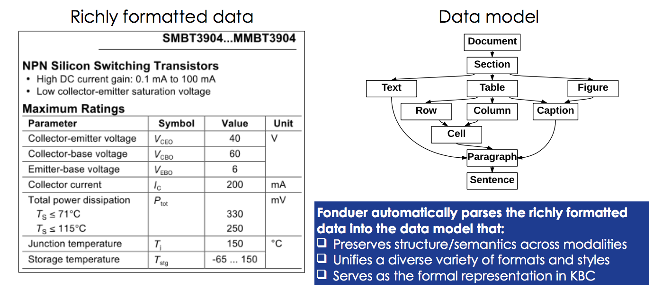
Fonduer: An example state-of-the-art system

Slide 41
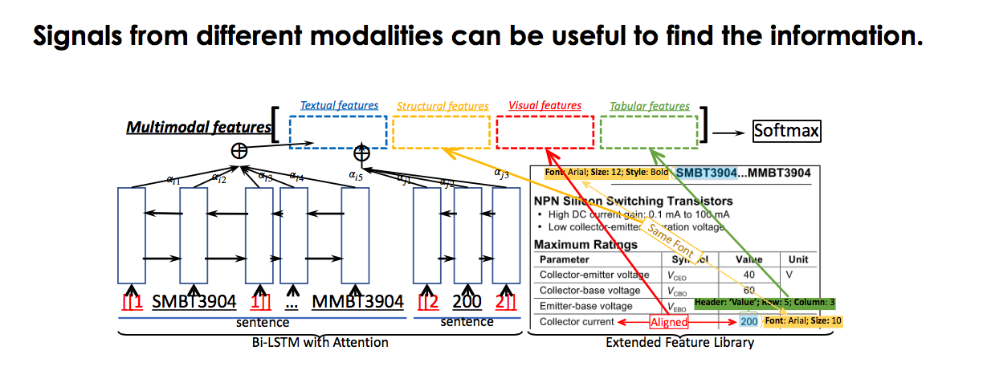
Fonduer: An example state-of-the-art system

